Slide 1
ARM Trustzone
Group 2
Jason Hill
Ryan Long
Joye Turnage
Jonathan Ashworth

Slide 2
What is Trustzone?
Trustzone overview
Deals with security features in many digital electronic devices such as:
  Set-top boxes
  Next-generation smart phones
  Payment and network equipment

Slide 3
What is Trustzone?
Software application built directly into the hard drive
Ensures that security is an intrinsic feature at the heart of any device

Slide 4
How does it work?
Memory Management Unit (MMU) & Caches- uses tables to determine which level a particular level of memory exists in
Secure Mode
Non-secure Mode

Slide 5
Modes of operation
Secure Mode- ensures that vital information is not intercepted by a third party
Non-secure Mode- allows more access to less protected information

Slide 6
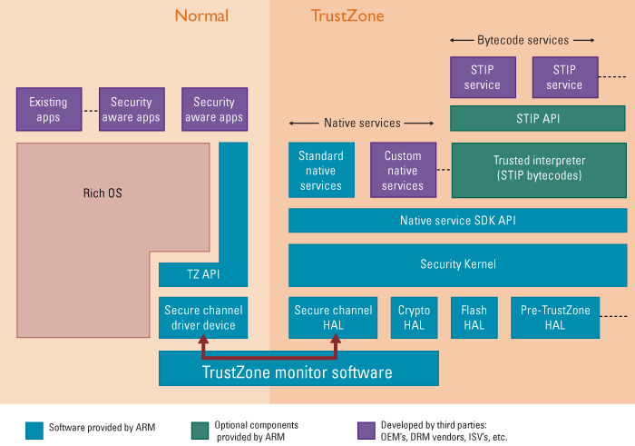
Trustzone Block Diagram

Slide 7
Applications
Over-the-Air Reprogramming
SIMLock Security
Terminal Identity
Managing Content
M-Wallet Transactions
Virtual Private Networks

Slide 8
Conclusion
Security is clearly a growing concern in many markets.
Trustzone uses a hardware-enforced security domain in order to systemize the implementation of secure systems.

Slide 9
Conclusion
Trustzone technology will make the development of secure applications easier, ultimately expanding the range of data services available to network administrators.

